Slide 1

Project Strategy
PURELL Inc.

Slide 2
Our Team
HEET SONI
KAUSHIK PATEL
RAJESH KUMAR
KARIK SOJITRA

Slide 3
Roadmap
01
02
03
04
Project Context, Scope, Objectives and Approach
Stakeholders and Team
Scheduling and Budget
Associated Risks and Risk Management

Slide 4
Project Context
On Nov-17-2019, china found the first confirmed case of the new Coronavirus. This virus is also known as COVID-19. It is scientifically verified that this virus only spreads via physical contact. Day by Day the number of infected people and deaths by this new coronavirus is increasing. Still, there is no vaccine available for this deadly virus. WHO provided various types of heath guidelines on how to prevent this virus from spreading. Sanitizing your hand repeatedly and wearing the face mask in the public is the most important guidelines from the WHO.
In a country like Canada, the virus is also spreading drastically and to prevent this, the government of Canada gave the order to the "PURELL" company to manufacture hand-sanitizers and face protection masks as soon as possible. The government will be funding the PURELL company for the production and the distribution of the hand sanitizers and face masks.

Slide 5
Project Scope and Objectives
The main goal of this project is to deliver the products as soon as possible in the given budget and timeline. Fab-1st-2020 will be the date for the project starting date and Apr-1st-2020 will be the project completion date.

Slide 6
Objectives
Partner up with the PURELL company to produce the required amount of hand sanitizers and face mask for the public distribution.
Complete the whole project as soon as possible.
Produce high-quality health products so the end-users can use it effortlessly.
Use the remaining budget to produce more health-safety related products.
distribute all the products in the whole country quickly.

Slide 7
Approach
Here for this project, The incremental project lifecycle with the hybrid development approach is recommended. This approach is suggested because,
In this pandemic situation, there will be more chances for errors and issues.
The government decided to deliver the products to the local stores as soon as possible and that's why the team will not get the chance to discuss the key requirements.
All the team members and leaders of this organization will be working the first time together, so there are chances of miss communications and going back and forth in the production time.
Due to fewer staff employees, it will be hard to produce and manage the products without errors.
Due to all these requirements, errors, staff issues, the incremental lifecycle model is required because The incremental project lifecycle allows the company to recheck and retake all the actions if any errors occur.

Slide 8
Approach Cont’d
This organization is a partnership-based organization. The government of Canada and the PURELL company will be coming together to achieve this task. Due to all these reasons, this approach is a hybrid development approach. When examining the project size and complexity the following can be determined:
1. This project is small to the medium-sized project because,
The duration of this project is around 3 months.
only a few employees will be working on this project due to social distancing.
The budget for this project is less than 0.6M and this project is limited to only this pandemic time duration.
2. The project has a medium to high complexity because,
Due to Coronavirus, the employees are worried to come for work.
Social distancing will slow down the production rate.
Lots of health risk involves.
The team is small, and the key requirements are not clearly defined.
All the products must be delivered in just 3 months.

Slide 9
Project Stakeholders
01
02
Internal
External
Project manager.
Project Team.
Project Sponsor.
Government Of Canada.
Vendors.
Customers.
End Users (Canadian).

Slide 10
Project Team
1
2
3
PROJECT MANAGER
WARE-HOUSE TEAM
MANUFACTURING TEAM
QUALITY TEAM
MANAGEMENT TEAM
BUDGET TEAM
DISTRIBUTER TEAM
4
5
6
7

Slide 11
Project Budget
Resources | Wage / Hour
Business Head | 70$
Project Manager | 65$
Manufacturing Head | 40$
Quality Head | 40$
Labour cost | 16$
Warehouse Head | 40$

Slide 12
Project Budget
$517,592
Description | Total Budget in $
Training cost | 20,800 $
Vendor and Raw materials | 410,000 $
Manufacturing cost | 60,592 $
Project Deliverables | 11,200 $
Overhead cost | 15,000 $
Total Budget Cost | 517,592 $

Slide 13
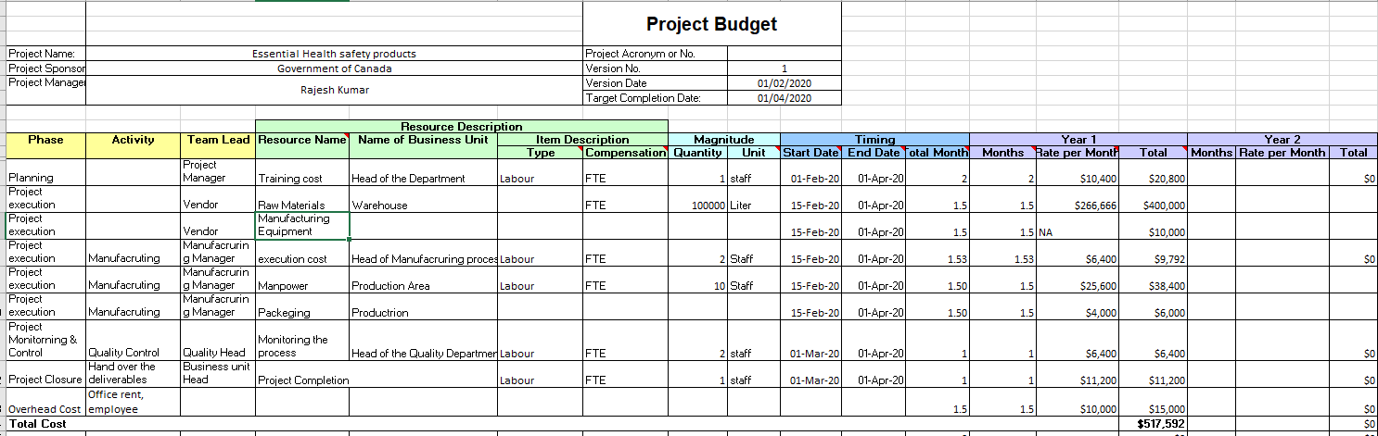
Project Budget

Slide 14
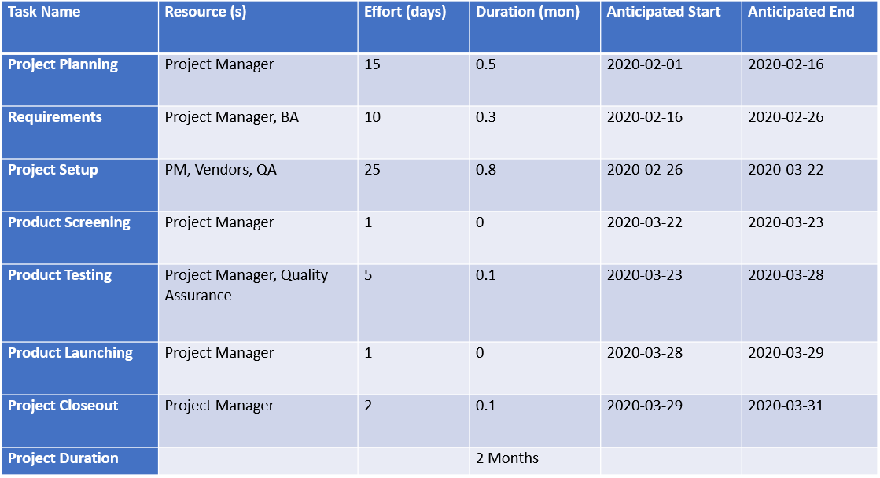
Project Schedule

Slide 15
Project Risk
In this project there are various risks related to COVID-19 that might affect the production of the products. The major risks that affect the project are as follows:
Production of the Products: Due to the pandemic there is an increased demand of the hand sanitizers and face masks. This makes it difficult for the company to manage the production of the products in a short span of time.
Lack of Coordination: As mentioned earlier in the project the team members are new and will be working with each other for the first time and hence, this will affect the work process as the there will be problem in the coordination among the members.
Delay in the Deliverables: Due to the pandemic the deadline of the project might be affected as the resources are less and the amount work to be completed is more.
Lack of Resources: the raw material needed for the production of the products are to ordered from other vendors and due to the lockdown the company will face difficulty in getting the resources on time.
Scarce Man Force: The contract given by the government is big enough that it requires more workforce and arranging the workforce in such short time is difficult.

Slide 16
Risk Registers
ID | RISK TYPE | RISK NAME | RISK OWNER | CURRENT LIKELIHOOD | CURRENT IMPACT
R1 | Internal Risk | Production of the Products | Manufacture Manager | 4 | 5
R2 | Internal Risk | Lack of Coordination | Project Manager | 3 | 4
R3 | Internal Risk | Delay in the deliverables | DISTRIBUTER manager | 4 | 4
R4 | Internal Risk | Lack of resources | Project Manager | 5 | 4
R5 | External Risk | Scarce man force | Project Manager | 2 | 4

Slide 17
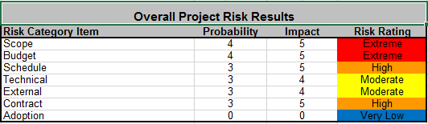
Risk Heat Map

Slide 18
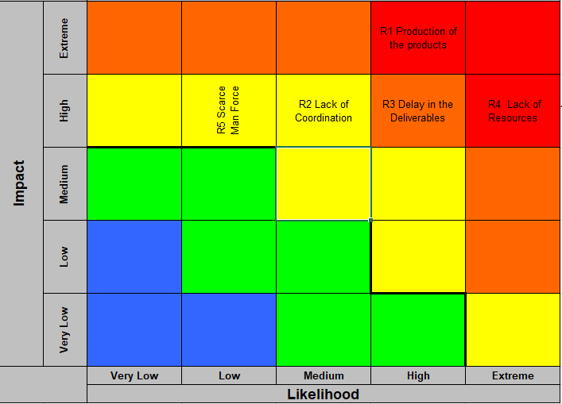
Risk Heat Map

Slide 19
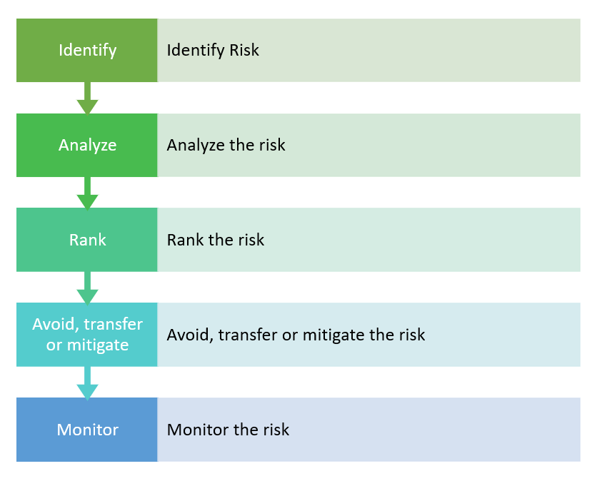
Project Risk Management

Slide 20
Project Change Management Process
Change request form
Submit a "Change request form"
Perform
Monitor & Upgrade the issue
Decide course of action and implement
Monitor
Analyze the impact of change
Analyze
Review the request
Review

Slide 21
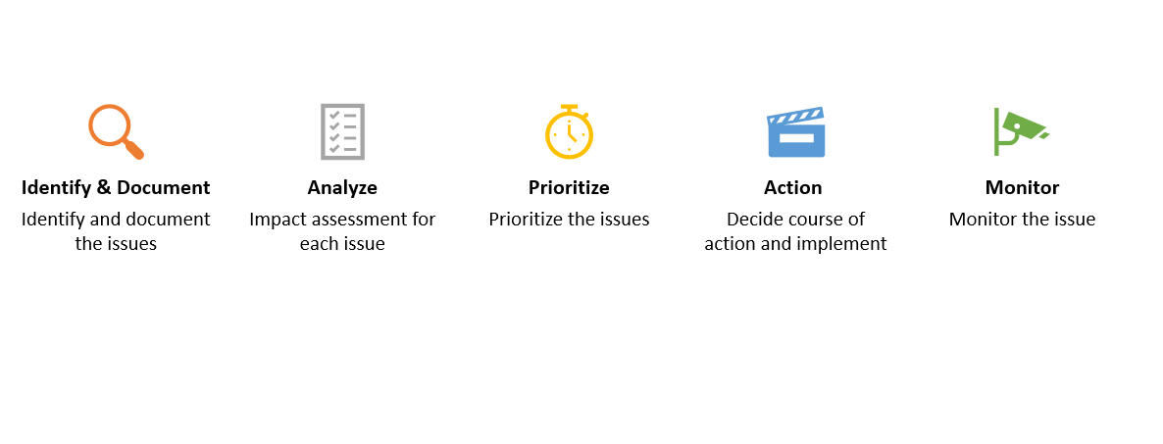
Issue Management

Slide 22
Concepts From The PMBOK
Project Stakeholder Management
Project Risk Management
Project Resource Management
Project Cost Management
Project Schedule Management
Human Resource Management
Communications Management

Slide 23
DATA Sheets
Project Budget Sheet
Project Budget Schedule Sheet
Project Risk management Sheet

Slide 24
THANK YOU

